Slide 1
Announcements
Tuesday, April 5th 4-8 PM, Student Council Fundraiser at Panda Express for Bastrop County Animal Shelter
CRCA Hoodies can be purchased from Mr. Gordon in the Library.
International Day is Friday, April 23rd from 1-3:30

Slide 2
Announcements
Monday, April 26th is the Last Day to Withdraw from ACC classes. Please speak with Mr. Gordon or Mr. Longoria before withdrawing.
Prom is May 1st 7-10 PM at McKinney Roughs for Juniors and Seniors. Tickets are now on sale. $30 for CRCA students before Apr. 9th.

Slide 3

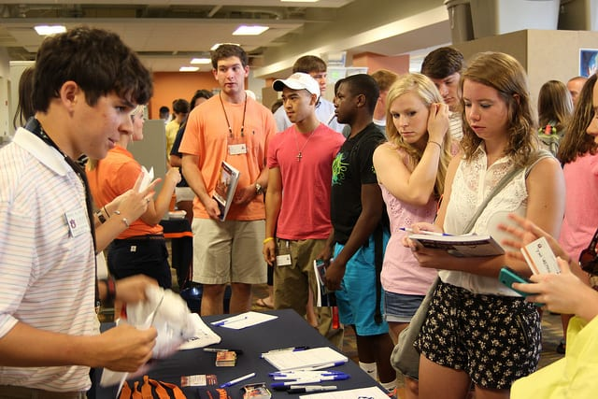
What is College orientation?
College Orientation is a way for universities to prepare incoming students for the transition from high school to college.
College orientation usually occurs over the summer between your high school graduation and first semester of college.
You must be admitted to the university to register for or attend orientation.

Slide 4
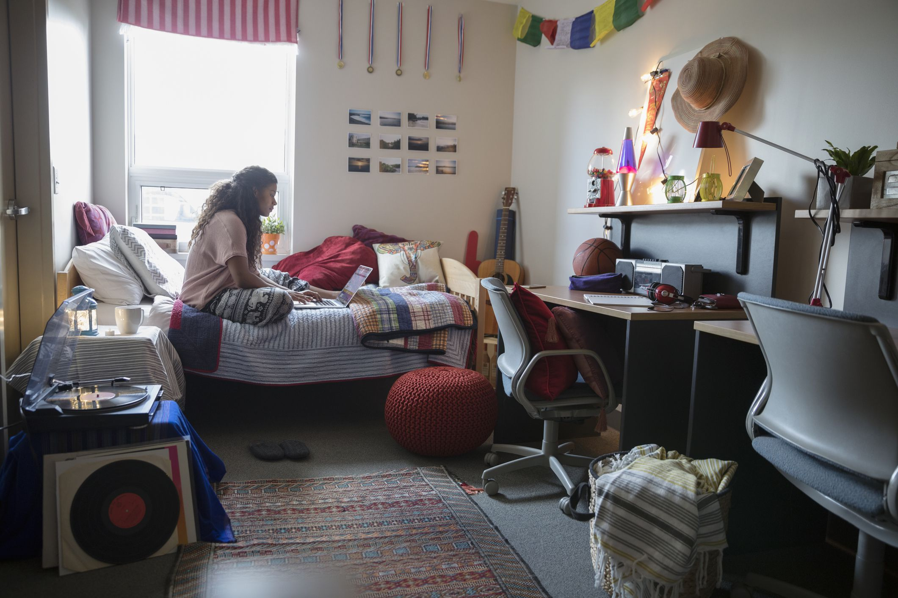
What is College orientation?
Registration for orientation is usually first-come, first-serve, so we always recommend to reserve your spot as early as possible.
Some university orientations are just one day, but many are two days long and require a night staying in a dormitory.

Slide 5
What happens at College orientation?
You will take a tour of the campus, see dorm rooms, eat in the cafeteria, and possibly meet some of your professors.
You will meet with a financial aid advisor to go over your student loans, grants, and scholarships.
You will meet with an academic counselor to pick your classes for the upcoming semester.

Slide 6

What happens at College orientation?
You will get your university ID printed.
You may meet your future roommates!
You will play games/ icebreakers with other incoming students.
Many times parents are invited to come. They will have a chance to visit the campus and meet with a financial aid advisor.

